Slide 1
Course: ARM Processor & Applications (15EECC207)
Faculty In Charge: Bhagyashree K., Preeti S. Pillai, Supriya K.

Slide 2
Course: ARM Processor & Applications
Course Outcomes (COs):
At the end of the course the student should be able to:
Discuss advanced microprocessor architecture and pipeline structure.
Write assembly language programs with a tradeoff between size and complexity and test it using development tools.
Develop an assembly level program for the given application using ARM or THUMB or both instruction set.
Discuss the concept of interrupt and their application.
Develop a C code for interfacing different ON/OFF board peripheral devices to LPC 2148 controller.

Slide 3
Unit-3 LPC 2148 Controller Architectural overview
Analog to Digital Converter(ADC)

Slide 4
Introduction
Analog signals are continuous, with infinite values in a given range. Digital signals have discrete values such as on/off or 0/1.
Limitations of analog signals
Analog signals pick up noise as they are being amplified.
Analog signals are difficult to store.
Analog systems are more expensive in relation to digital systems.

Slide 5

Introduction
Advantages of digital systems (signals)
Noise can be reduced by converting analog signals in 0s and1s.
Binary signals of 0s/1s can be easily stored in memory.
Technology for fabricating digital systems has become so advanced that they can be produced at low cost.
The major limitation of a digital system is how accurately it represents the analog signals after conversion.

Slide 6
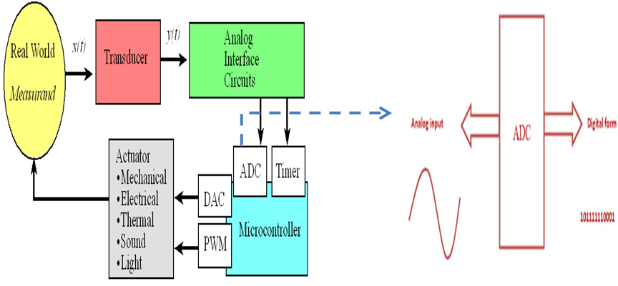
Introduction

Slide 7
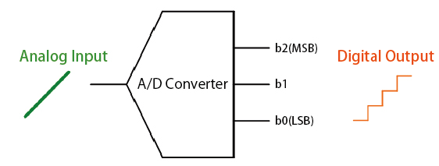
Analog to Digital Converter
The A/D converter breaks up (samples) the amplitude of the analog signal at discrete intervals, which are then converted into digital values. The resolution of an analog to digital converter (indicating the number of discrete values it can produce over a range of analog values) is typically expressed by the number of bits. In the above case of a 3bit A/D converter, the upper value (b2) is referred to as the Most Significant Bit (MSB) and the lowest value (b0) the Least Significant Bit (LSB).

Slide 8
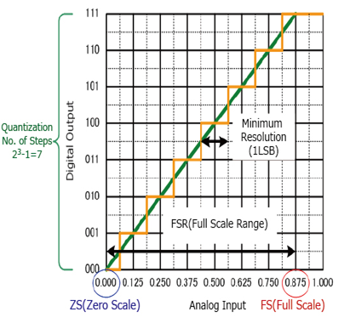
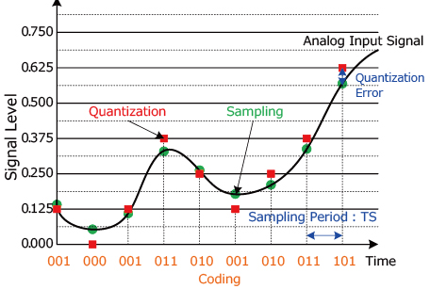
Conversion steps
In order to change an analog signal to digital, the input analog signal is sampled at a high rate of speed.
The amplitude at each of those sampled moments is converted into a number equivalent – this is called quantization.
These numbers are simply the combinations of the 0s and 1s used in computer language – this called encoding.

Slide 9
Resolution
Resolution (number of discrete values the converter can produce) = Analog Quantization size (Q)
(Q) = Vrange / 2^n, where Vrange is the range of analog voltages which can be represented
limited by signal-to-noise ratio (should be around 6dB)
In our previous example: Q = 1.25V, this is a high resolution. A lower resolution would be if we used a 2-bit converter, then the resolution would be 10/2^2 = 2.50V.

Slide 10
Accuracy of A/D Conversion
There are two ways to best improve accuracy of A/D conversion:
Increasing the resolution which improves the accuracy in measuring the amplitude of the analog signal.
Increasing the sampling rate which increases the maximum frequency that can be measured.

Slide 11
Types of ADC
Converters
Flash ADC
Delta-Sigma ADC
Dual Slope (integrating) ADC
Successive Approximation ADC

Slide 12
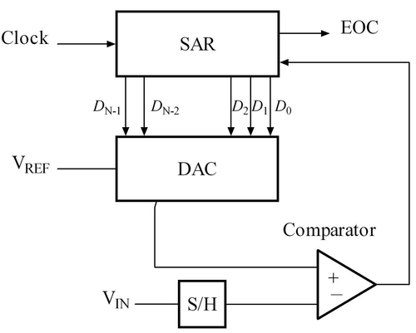
SAR –Successive Approximation Register
Successive approximation ADC
V_{IN} is approximated as a static value in a sample and hold (S/H) circuit
the successive approximation register (SAR) is a counter that increments each clock as long as it is enabled by the comparator
the output of the SAR is fed to a DAC that generates a voltage for comparison with V_{IN}
when the output of the DAC = V_{IN} the value of SAR is the digital representation of V_{IN}

Slide 13
On-chip ADC :LPC2148
Two 10 bit successive approximation analog to digital converters.
Input multiplexing among 6 or 8 pins (ADC0 and ADC1). AD0.7:6, AD0.4:1&AD1.7:0
Power-down mode.
Measurement range 0 V to VREF (typically 3 V; not to exceed VDDA voltage level).
10 bit conversion time ≥ 2.44µ s.
Burst conversion mode for single or multiple inputs.
Global Start command for both converters .
A programmable divider is included in each converter, to scale this clock to the 4.5 MHz (max) clock needed by the successive approximation process.
A fully accurate conversion requires 11 of these clocks.

Slide 14
Registers related to ADC0
AD0CR:ADC Control register
AD0CR= 0x09200010;
31 | 30 | 29 | 28 | 27 | 26 | 25 | 24 | 23 | 22 | 21 | 20 | 19 | 18 | 17 | 16 | 15 | 14 | 13 | 12 | 11 | 10 | 9 | 8 | 7 | 6 | 5 | 4 | 3 | 2 | 1 | 0
0 | 0 | 0 | 0 | 1 | 0 | 0 | 1 | 0 | 0 | 1 | 0 | 0 | 0 | 0 | 0 | 0 | 0 | 0 | 0 | 0 | 0 | 0 | 0 | 0 | 0 | 0 | 1 | 0 | 0 | 0 | 0
R |  |  |  | E | SOC |  |  | R |  | O | R | CLKS |  |  | B | CLK DIV(4.5MHz) |  |  |  |  |  |  |  | ADC PIN SEL BITs

Slide 15
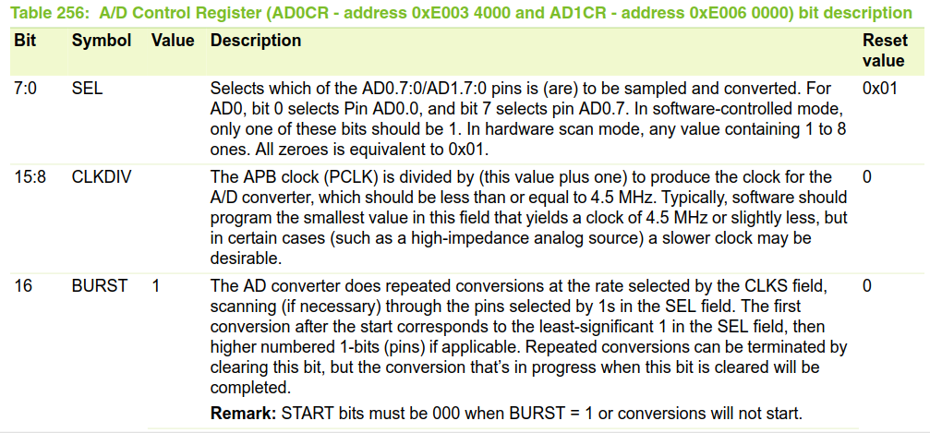

Slide 16
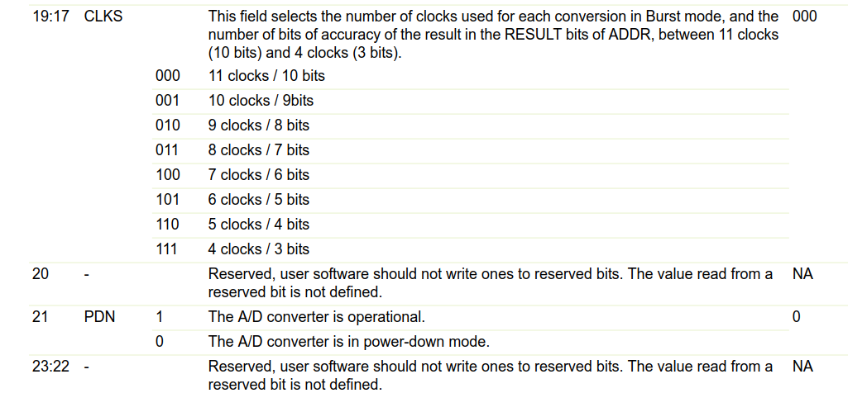

Slide 17
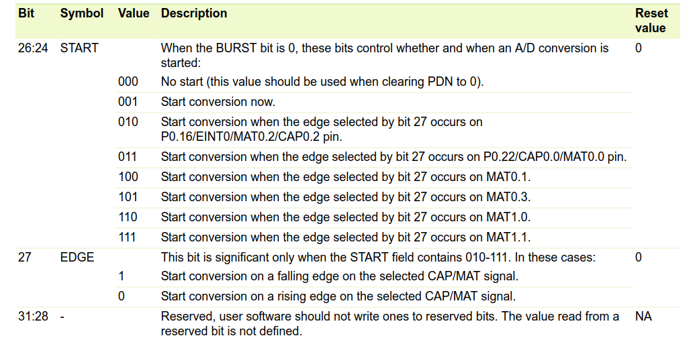

Slide 18
Registers related to ADC0(contd)
AD0GDR-ADC0 Global Data Register
AD0GDR
31 | 30 | 29 | 28 | 27 | 26 | 25 | 24 | 23 | 22 | 21 | 20 | 19 | 18 | 17 | 16 | 15 | 14 | 13 | 12 | 11 | 10 | 9 | 8 | 7 | 6 | 5 | 4 | 3 | 2 | 1 | 0
1 |  |  |  |  |  |  |  |  |  |  |  |  |  |  |  | 1 | 1 | 1 | 1 | 1 | 1 | 1 | 1 | 1 | 1
EOC |  |  |  |  |  |  |  |  |  |  |  |  |  |  |  | 10-bit Data(digital) Ex.3FF(full Scale)
IOSET0 Register for LCD
31 | 30 | 29 | 28 | 27 | 26 | 25 | 24 | 23 | 22 | 21 | 20 | 19 | 18 | 17 | 16 | 15 | 14 | 13 | 12 | 11 | 10 | 9 | 8 | 7 | 6 | 5 | 4 | 3 | 2 | 1 | 0

Slide 19
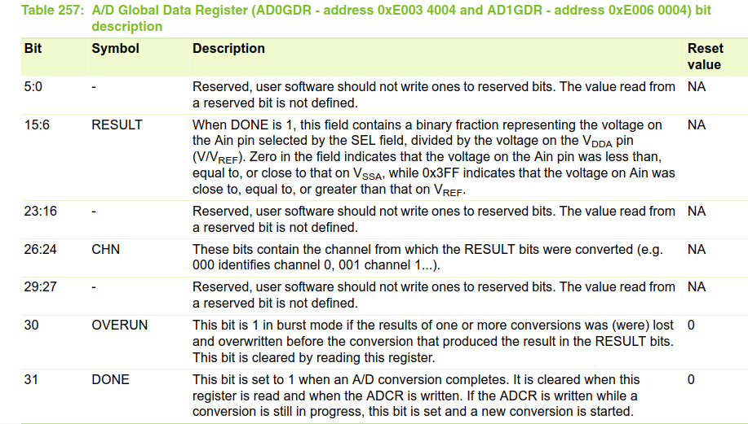

Slide 20
PROGRAM
#include <lpc214x.h>
#include <Stdio.h>
unsigned int i;
void lcd_init(void);
void delay(unsigned long int);
void cmd(unsigned int );
void hascii(int *);
unsigned int adc_value=0,temp_adc=0;
void data(unsigned int );
int temp;
int var[10];
char val[10];
int main()
{ PINSEL1 = 0X00040000; //AD0.4 pin is selected(P0.18)
IO0DIR = 0x000000FC; //configure o/p lines for lcd
lcd_init();

Slide 21
while(1)
{
//CONTROL register for ADC
AD0CR = 0x09200010; //command register for ADC-AD0.4
delay(100);
while((temp_adc = AD0GDR) == 0x80000000); //to check the interrupt bit
adc_value = AD0GDR; //reading the ADC value
adc_value >>=6;
adc_value &= 0x000003ff;
temp=adc_value & 0x00000f00;
var[0]= temp>>8 ;
temp=adc_value & 0x000000f0;
var[1]= temp>>4;
temp=adc_value & 0x0000000f;
var[2]=temp;

Slide 22
hascii(var);
for(i=0;i<3;i++)
{
delay(32000);
data(val[i]);
delay(32000); delay(32000); delay(32000);
}
cmd(0x01); delay(120000); delay(120000);
}
}

Slide 23
void delay(unsigned long int r1)
{
unsigned long int r;
for(r=0;r<r1;r++);
}
void hascii(int var[])
{
char asc[20]={'0','1','2','3','4','5','6','7','8','9','A','B','C','D','E','F'};
for (i=0;i<3;i++)
val[i]=asc[var[i]];
}

Slide 24
REFERENCES
UM10139 Volume 1: LPC214x User Manual Rev. 02 — 25 July 2006 User manual LPC214x

Slide 25
THANK YOU

